Slide 1


Team 6 Final Project

Slide 2

TOMAS SAMUOLIS PROJECT LEAD
OGHENERUKEVWE OMUSI DATA ENGINEER CO-PROJECT MANAGER
Noga Starobinski Data Analyst
Devon Solheim Data Engineer Co-Project Manager
Kristen Bestavros Data Analyst Co-Project Manager
Sara Patel
Data Engineer

Slide 3


Our Metrics
PUBLIC INFORMATION CAMPAIGNS
WORKPLACE CLOSING
LEVEL 0 No COVID-19 public information campaign
LEVEL 2 Require closing (or work from home) for some sectors or categories of workers
LEVEL 3 Require closing (or work from home) for all-but-essential workplaces (i.e. grocery stores, doctors)

Slide 4
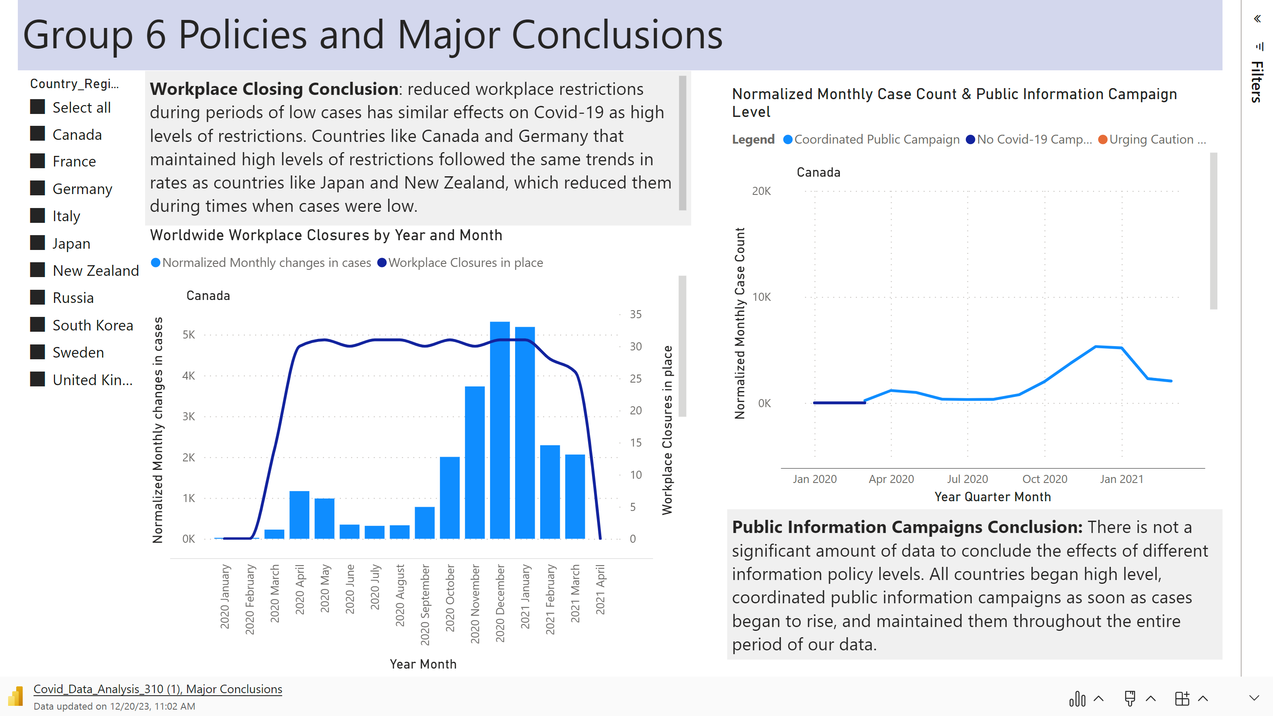

Slide 5
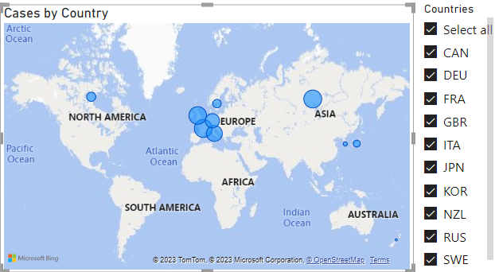
BASELINE STATS

Slide 6
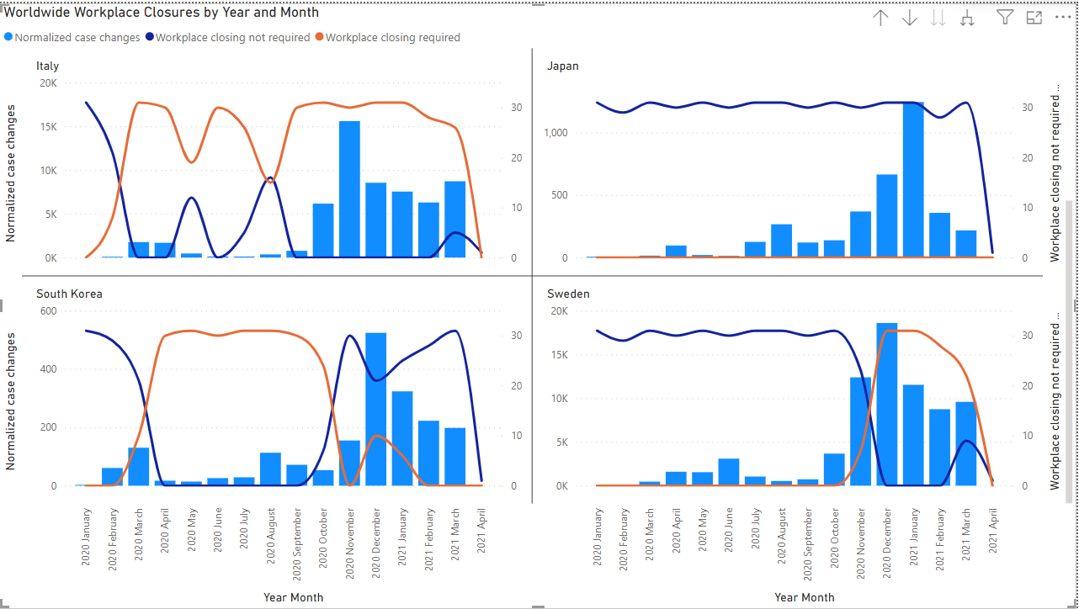
Workplace CLosing

Slide 7
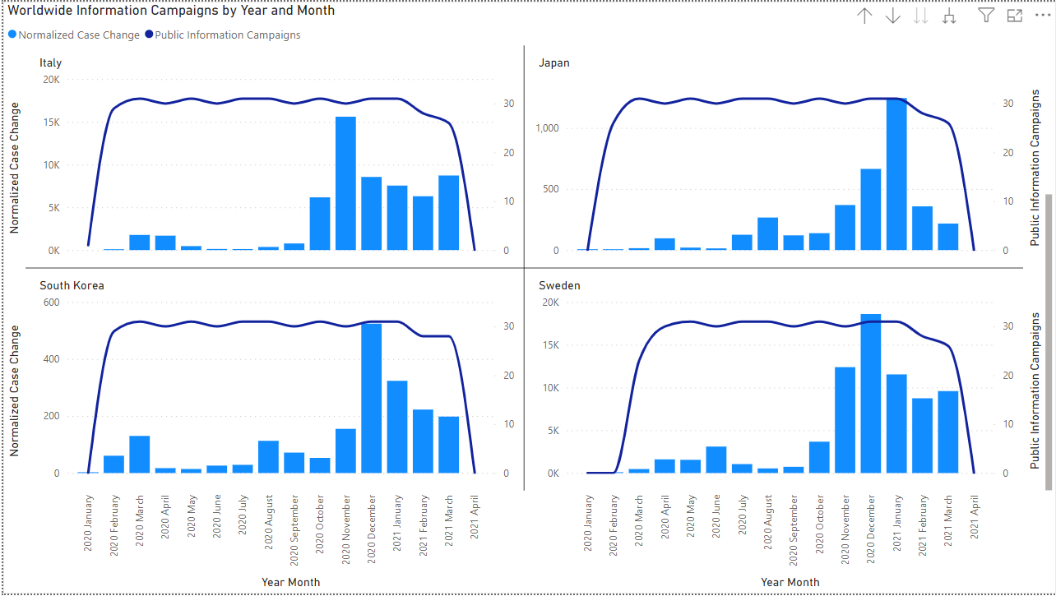
Public Information Campaigns

Slide 8

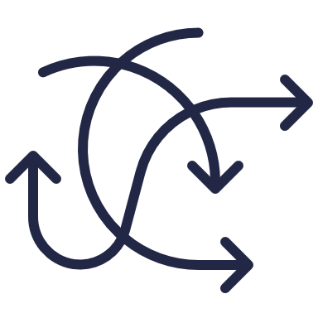

CHALLENGES
STRUCTURING
DATAFLOW
CLEANING AND UNDERSTANDING DATA
INTERPRETING
RESULTS
Difficulty with organizing the different dimensions of the datasets without a clear understanding of the dataflow structure
The datasets contained a lot of noise and unusable information. We had to be cautious when deciding what data to use
Comparing policies and their impacts was time consuming

Slide 9


Our Recommendation
Best Policies to Implement
Policy 1 Immediately implement coordinated public information campaign at first signs of virus
Policy 2 Implement workplace closures when cases are high

Slide 10

CONCLUSION
Policies dictate how people view COVID-19 and adjust their lifestyles to avoid it
Implementing effective policies can be powerful in reducing the stress placed on healthcare facilities and reducing death count

Slide 11

Thank You!

